Slide 1
Security, Safety, and Hacking
ELEG 491
Spring 2020

Slide 2
IEEE Code of Ethics (section 7.8)
We…do hereby commit ourselves to the highest ethical and professional conduct and agree:
to hold paramount the safety, health, and welfare of the public, to strive to comply with ethical design and sustainable development practices, and to disclose promptly factors that might endanger the public or the environment;

Slide 3
Safety vs. Liberty:
“two sides of a single coin”
Benjamin Franklin: “They who can give up essential liberty to obtain a little temporary safety, deserve neither liberty nor safety.”
Is this motto outdated?

Slide 4
U.S. Law on I.T. Security
Telecommunications | Telecommunications Deregulation and Competition Act of 1996— Update to Communications Act of 1934 (47 USC 151 et seq.) | 1934 | Regulates interstate and foreign telecommunications (amended 1996 and 2001)
Freedom of information | Freedom of Information Act (FOIA) | 1966 | Allows for the disclosure of previously unreleased information and documents controlled by the U.S. government
Privacy | Federal Privacy Act of 1974 | 1974 | Governs federal agency use of personal information
Copyright | Copyright Act of 1976—Update to U.S. Copyright Law (17 USC) | 1976 | Protects intellectual property, including publications and software
Cryptography | Electronic Communications Privacy Act of 1986 (Update to 18 USC) | 1986 | Regulates interception and disclosure of electronic information; also referred to as the Federal Wiretapping Act
Access to stored communications | Unlawful Access to Stored Communications (18 USC 2701) | 1986 | Provides penalties for illegally accessing stored communications (such as e-mail and voicemail) stored by a service provider
Threats to computers | Computer Fraud and Abuse Act (also known as Fraud and Related Activity in Connection with Computers) (18 USC 1030) | 1986 | Defines and formalizes laws to counter threats from computer-related acts and offenses (amended 1996, 2001, and 2006)
Federal agency information security | Computer Security Act of 1987 | 1987 | Requires all federal computer systems that contain classified information to have security plans in place, and requires periodic security training for all individuals who operate, design, or manage such systems
Trap and trace restrictions | General prohibition on pen register and trap and trace device use; exception (18 USC 3121 et seq.) | 1993 | Prohibits the use of electronic "pen registers" and trap and trace devices without a court order
Criminal intent | National Information Infrastructure Protection Act of 1996 (update to 18 USC 1030) | 1996 | Categorizes crimes based on defendant’s authority to access a protected computer system and criminal intent
Trade secrets | Economic Espionage Act of 1996 | 1996 | Prevents abuse of information gained while employed elsewhere
Personal health information protection | Health Insurance Portability and Accountability Act of 1996 (HIPAA) | 1996 | Requires medical practices to ensure the privacy of personal medical information
Encryption and digital signatures | Security and Freedom through Encryption Act of 1997 | 1997 | Affirms the rights of persons in the United States to use and sell products that include encryption and to relax export controls on such products
Intellectual property | No Electronic Theft Act Amends 17 USC 506(a)—copyright infringement, and 18 USC 2319—criminal infringement of copyright (Public Law 105-147) | 1997 | Amends copyright and criminal statues to provide greater copyright protection and penalties for electronic copyright infringement
(Whitman & Mattord, 2012, Principles of Information Security, 5th ed.)

Slide 5
I.T. Security Laws (cont.)
Copy protection | Digital Millennium Copyright Act (update to 17 USC 101) | 1998 | Provides specific penalties for removing copyright protection from media
Identity theft | Identity Theft and Assumption Deterrence Act of 1998 (18 USC 1028) | 1998 | Attempts to instigate specific penalties for identity theft by identifying the individual who loses their identity as the true victim, not just those commercial and financial credit entities who suffered losses
Banking | Gramm-Leach-Bliley Act of 1999 (GLB) or the Financial Services Modernization Act | 1999 | Repeals the restrictions on banks affiliating with insurance and securities firms; has significant impact on the privacy of personal information used by these industries
Terrorism | USA PATRIOT Act of 2001 (update to 18 USC 1030) | 2001 | Defines stiffer penalties for prosecution of terrorist crimes
Accountability | Sarbanes-Oxley Act of 2002 (SOX) or Public Company Accounting Reform and Investor Protection Act | 2002 | Enforces accountability for executives at publicly traded companies; this law is having ripple effects throughout the accounting, IT, and related units of many organizations
Spam | Controlling the Assault of Non- Solicited Pornography and Marketing Act of 2003 CAN-SPAM Act (15 USC 7701 et seq.) | 2003 | Sets the first national standards for regulating the distribution of commercial email; the act includes mobile phone spam as well
Fraud with access devices | Fraud and Related Activity in Connection with Access Devices (18 USC 1029) | 2004 | Defines and formalizes law to counter threats from counterfeit access devices like ID cards, credit cards, telecom equipment, mobile or electronic serial numbers, and the equipment that creates them
Terrorism and extreme drug trafficking | USA PATRIOT Improvement and Reauthorization Act of 2005 (update to 18 USC 1030) | 2006 | Renews critical sections of the USA PATRIOT Act

Slide 6
Notice connections to later topics:
Just as privacy, liberty, safety and security are related, so are:
Security and: hacking, crime, cyberwar, emerging technologies, responsibility…

Slide 7
What is the difference between security and safety?
Leveson & Young:
“Safety: prevent losses due to
unintentional actions by benevolent actors…
Security: prevent losses due to intentional actions by malevolent actors”
[“Engineering a Safer (and More Secure) World” ASAC Workshop 2013 https://www.acsac.org/2013/workshops/law/files/LAW-2013-Leveson.pdf]

Slide 8
Leveson: Failure on the event chain (accident) model
Isolate the proximate or root cause
Label all other conditions contributory
Focus on direct causality (necessary conditions, i.e. if event X had not occurred, then the following event Y would not have occurred) and ignore reasons for failure
This might have worked for simpler electro-mechanical systems, but doesn’t work for many safety-critical systems

Slide 9
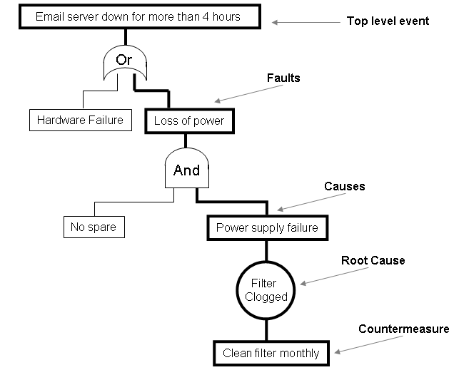

Hank Marquis, Fault Tree Analysis Made Easy: http://www.itsmsolutions.com/newsletters/DITYvol1iss5.htm

Slide 10
Leveson: failure accounts are causal explanations
“The selection of events to include in an event chain is dependent on the stopping rule used to determine how far back the sequence of explanatory events goes. Although it is common to isolate one or more events or conditions (usually at the beginning of chain) and call them the cause or the proximate, direct or root cause of an accident or incident and to label the other events or conditions as contributory, there is no basis for this distinction.“

Slide 11
Leveson (cont.)
The “root cause” is selected as:
(1) familiar and easily acceptable
(2) a deviation from a standard
(3) the first “curable” event in the chain
(4) politically acceptable

Slide 12
Why is the event chain model (now) inadequate?
Many systems are software intensive
Human-machine systems have a different kind of complexity
Feedback and indirect causality abound!
Decision-making is now distributed
Mix of physical and organizational boundaries
Other such phenomena: biological systems

Slide 13
Two kinds of failure
Individual Component(s) failure
Dysfunctional interactions btw. non-failed components (often unpredictable)
E.g. the Mars Polar Lander descent control SW
“In this and in most software-related accidents, the software operates exactly as specified, that is, the software, following its requirements, commands component behavior that violates system safety constraints or the software design contributes to unsafe behavior by human operators.”

Slide 14
Event Chain failure models…
“rest on traditional analytic reduction: Physical systems are decomposed into separate physical components so the parts can be examined separately, and behavior is decomposed into events over time. This decomposition assumes that such separation is feasible: that is, each component or subsystem operates independently and analysis results are not distorted when the components are considered separately. This assumption in turn implies (1) that the components or events are not subject to feedback loops and non-linear interactions and (2) that the behavior of the components is the same when examined alone as when they are playing their part in the whole.”

Slide 15
A systems approach to safety…
“takes a broader view by focusing on what was wrong with the system’s design or operations that allowed the accident to take place. The proximal events that precede an accident are simply symptoms of a lack of enforcement of safety in the design and operation of the system: to prevent accidents we need to go beyond the events to understand why those events occurred, i.e., the larger system and process producing the events.”

Slide 16
Leveson’s replacement: STAMP (systems-theoretic accident modeling and processes)
Hierarchy of levels of organization
Safety as an emergent property at a level
(E.g. questions about the safety of a single valve in a plant are meaningless; we have to know how the value is used and controlled)
Accidents arise from inadequate control or enforcement of safety-related constraints on the design, development, and operation of the system.

Slide 17
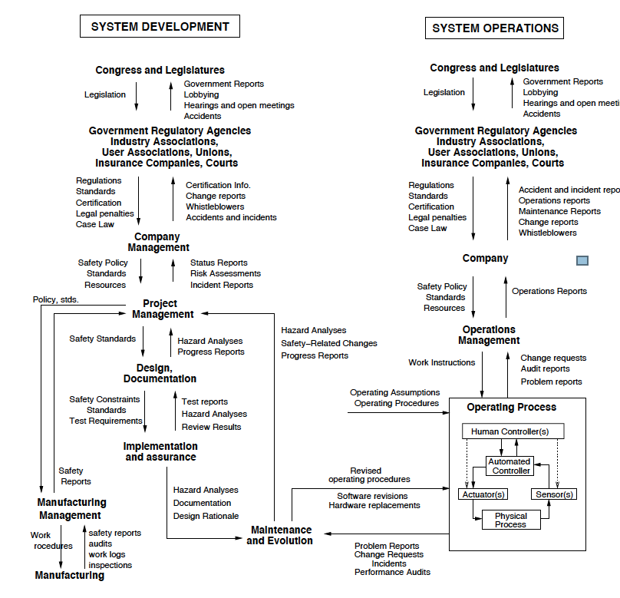

Slide 18
More about SW: Cantwell-Smith and the “limits of correctness”
Note computers’ special dependence on models:
“you write an explicit description of the model down inside the computer, in the form of a set of rules or what are called representations… the facts and data thought to be relevant to the system’s behavior.”

Slide 19
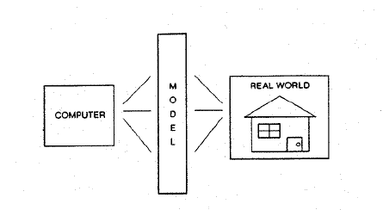
A model for models

Slide 20
Models…
Deal with subject at some level of abstraction
Must ignore certain things (always partial)
Differ from the world, which is not partial
(in theory) tell you how your representations correspond to your model, not how your representations correspond to the world

Slide 21
Cantwell-Smith’s “other” worries
Complexity: how much code is there?
Human Interaction (cf. Leveson)
Levels of Failure (cf. Leveson): hardware, software, model
“in order to be reliable, a system has to be correct at every relevant level”

Slide 22
Hacking: A threat or a benefit to safety and security?
Pro: Hacking reveals vulnerabilities and improves system safety and security
Con: Hacking is in itself a harm
(estimates range from billions to trillions of USD)

Slide 23
The Hacker Ethic
(Steven Levy, 1984)
1. Access to computers should be unlimited and total.
2. Always yield to the Hands-On Imperative
3. All information should be free.
4. Mistrust authority--promote decentralization.
5. Hackers should be judged by their hacking.
6. You can create art and beauty on a computer.
7. Computers can change your life for the better.
(from Hackers: Heroes of the Computer Revolution (Anchor/Doubleday: 1984), from http://mosaic.echonyc.com/~steven/hackers.html)

Slide 24
The MIT “Hacker Ethic” http://hacks.mit.edu/Hacks/misc/ethics.html
A hack must:
be safe
not damage anything
not damage anyone, either physically, mentally or emotionally
be funny, at least to most of the people who experience it
There is no way of enforcing this code, but anything that directly contradicts it will probably not be considered a "hack" by most of the MIT community.

